Slide 1

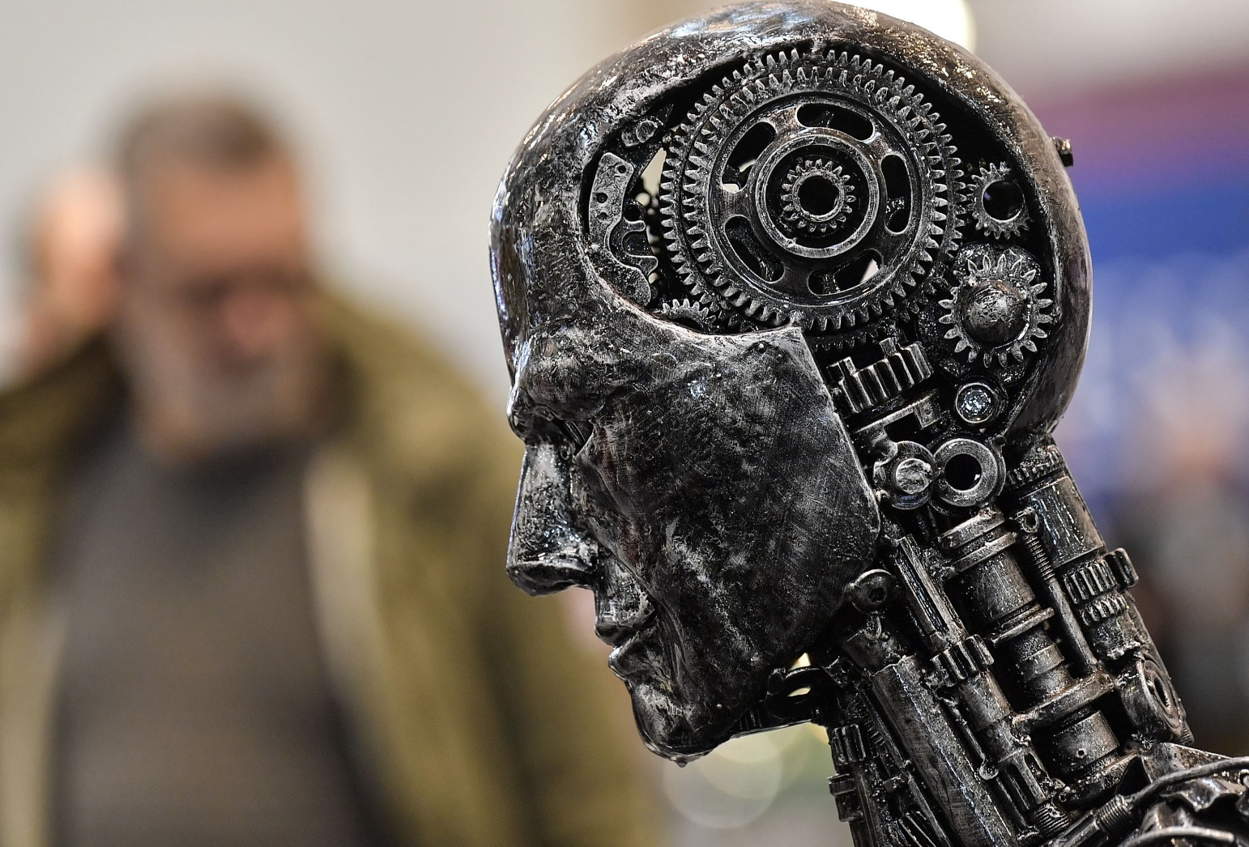
Artificial Intelligence (AI) Name: Akin Bin Mostofa Kamal ID:193-15-13394 Section: C

Slide 2
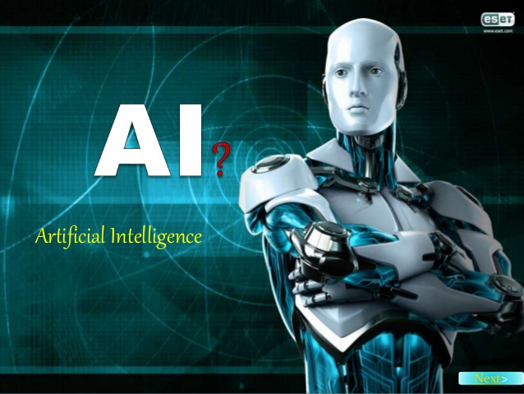
What Is Artificial Intelligence (AI)?

Slide 3
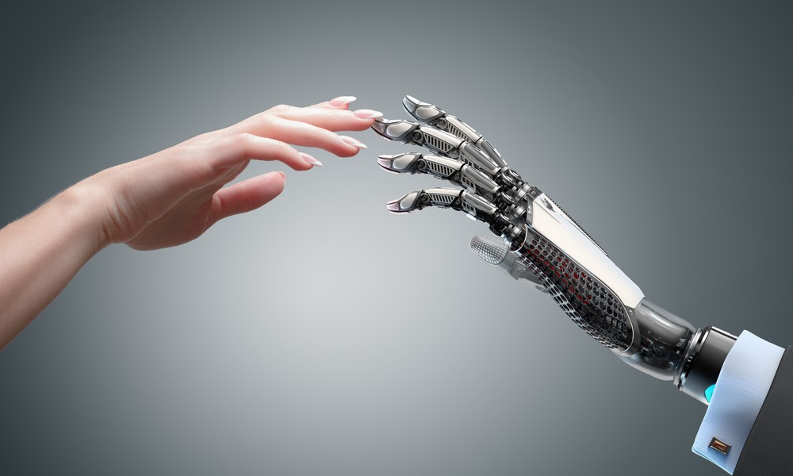
Artificial intelligence (AI)
Artificial intelligence (AI) is wide-ranging branch of computer science concerned with building smart machines capable of performing tasks that typically require human intelligence.

Slide 4
Types Of Artificial intelligence (AI) :
Four types of Artificial intelligence (AI) :
Reactive Machines
Limited Memory
Theory of Mind
Self-awareness

Slide 5
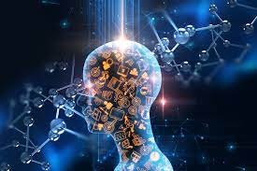
Reactive Machines:
Reactive machines are the simplest level of robot. They cannot create memories or use information learnt to influence future decisions – they are only able to react to presently existing situations

Slide 6
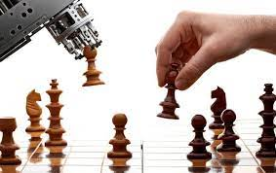
Example of Reactive Machines : IBM chess program

Slide 7

Limited Memory:
A limited memory machine, as the name might suggest, is able to retain some information learned from observing previous events or data.

Slide 8
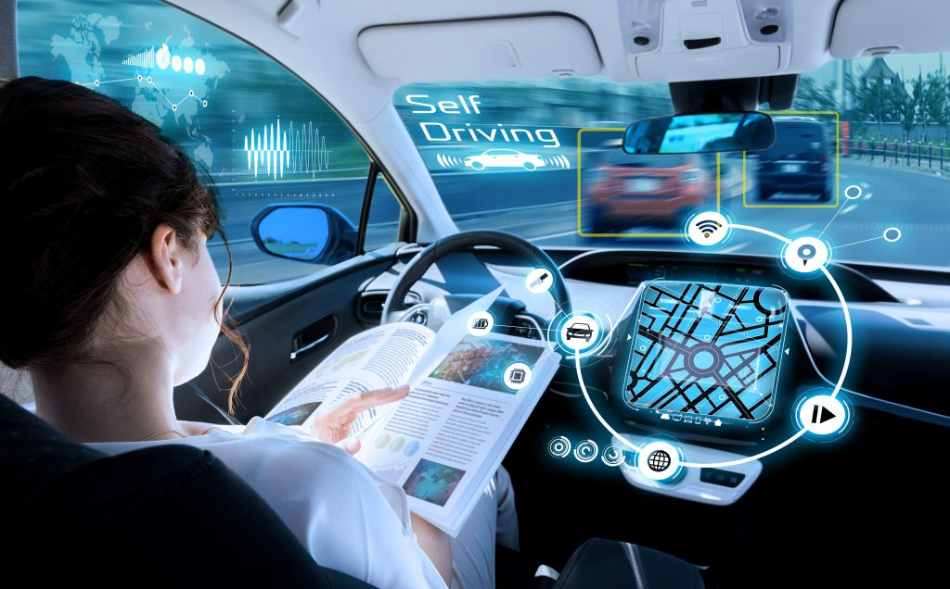
Example of Limited Memory: Self-driving cars

Slide 9
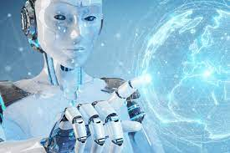
Theory of Mind:
Human beings have thoughts and feelings, memories or other brain patterns that drive and influence their behaviour.

Slide 10
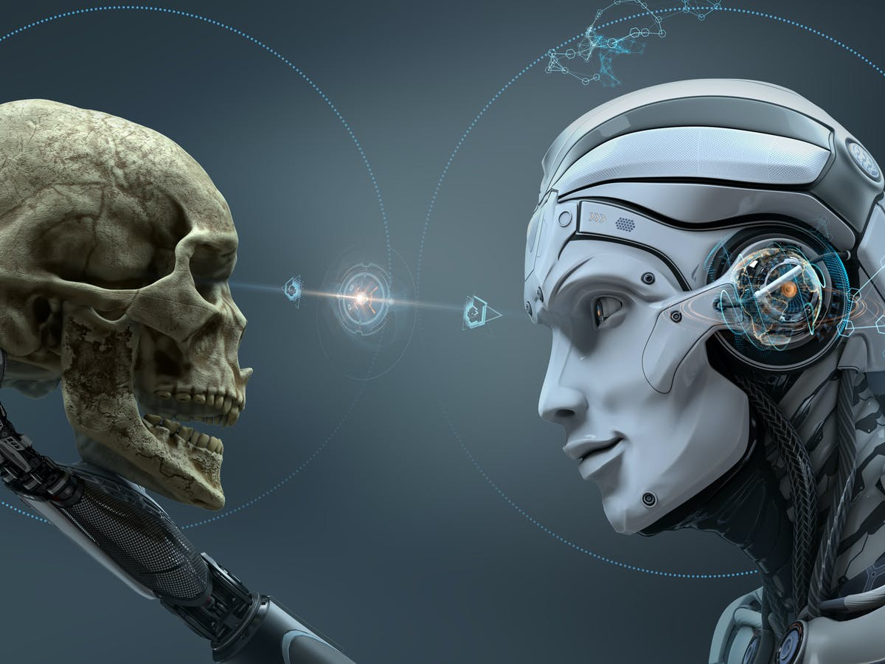
Example of Theory of Mind: Various emotions of different people

Slide 11
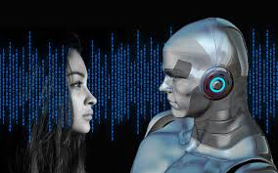
Self-awareness:
Self-awareness AI machines are the most complex that we might ever be able to envision and are described by some as the ultimate goal of AI.

Slide 12
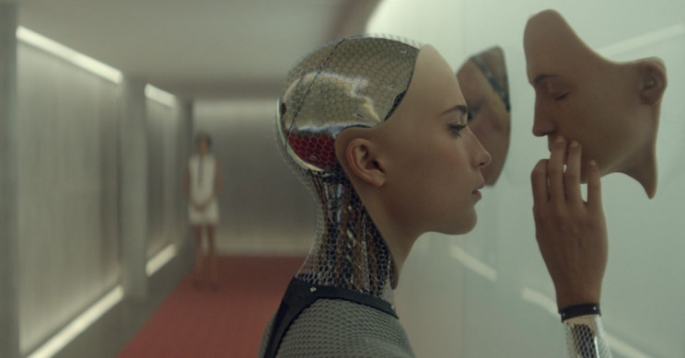
Example of Self-awareness: Self-simulation of itself

Slide 13
Thank You Abu Khalid Mubashshir Mahmud Sir 😍

